Slide 1

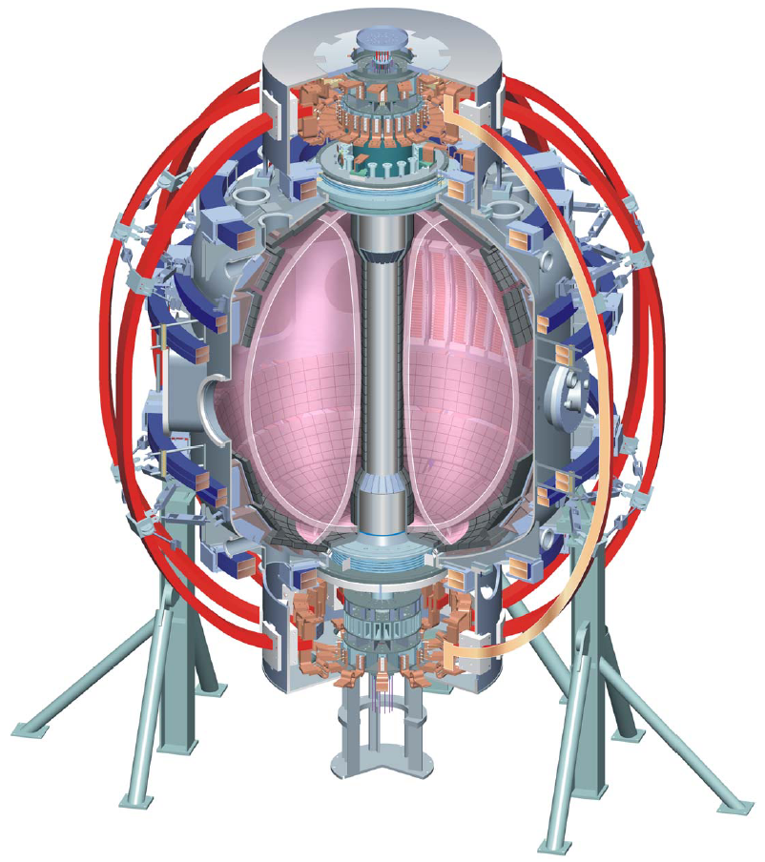
Supported by
Boundary Physics Topical Science Group Discussion Plan
College W&M
Colorado Sch Mines
Columbia U
Comp-X
General Atomics
INEL
Johns Hopkins U
LANL
LLNL
Lodestar
MIT
Nova Photonics
New York U
Old Dominion U
ORNL
PPPL
PSI
Princeton U
SNL
Think Tank, Inc.
UC Davis
UC Irvine
UCLA
UCSD
U Colorado
U Maryland
U Rochester
U Washington
U Wisconsin
V. A. Soukhanovskii, TSG Leader
Lawrence Livermore National Laboratory, Livermore, CA
R. Maingi, TSG Deputy
Oak Ridge National Laboratory, Oak Ridge, TN
D. P. Stotler, Theory & Modeling
Princeton Plasma Physics Laboratory, Princeton, NJ
FY 2010 NSTX Research Forum
1 December 2009
Princeton, NJ
Culham Sci Ctr
U St. Andrews
York U
Chubu U
Fukui U
Hiroshima U
Hyogo U
Kyoto U
Kyushu U
Kyushu Tokai U
NIFS
Niigata U
U Tokyo
JAEA
Hebrew U
Ioffe Inst
RRC Kurchatov Inst
TRINITI
KBSI
KAIST
POSTECH
ASIPP
ENEA, Frascati
CEA, Cadarache
IPP, Jülich
IPP, Garching
ASCR, Czech Rep
U Quebec

Slide 2
Boundary Physics TSG priorities are defined by
DOE and NSTX Milestones
  FY2010 DOE Joint Research Target: Conduct experiments on major fusion facilities to improve understanding of the heat transport in the tokamak scrape-off layer (SOL) plasma, strengthening the basis for projecting divertor conditions in ITER.
  FY2010 Research Milestone R(10-3): Assess H-mode pedestal characteristics and ELM stability as a function of collisionality and lithium conditioning
  FY2011 DOE Joint Research Target: Conduct experiments on major fusion facilities to improve the understanding of the physics mechanisms responsible for the structure of the pedestal and compare with the predictive models described in the companion theory milestone.
NSTX-U planning needs and ST development path needs
ITPA participation, ITER needs

Slide 3
Boundary Physics TSG is actively involved in a number of ITPA PEP and DSOL experiments
DSOL (= Divertor and Scrape-off layer)
  DSOL-17: Introduction of pre-characterized dust in divertor and SOL
PEP (= Pedestal and Edge)
  PEP-19: Basic mechanisms of edge transport with RMPs in toroidal plasma confinement devices
    Proposals at this forum (J.-W. Ahn, A. Loarte)
  PEP-25: Inter-machine comparison of ELM control by magnetic field perturbations from midplane RMP coils
    NSTX contributing through experiments on ELM triggering with RMP
  PEP-6: Pedestal structure and ELM stability in DN
    Data will be taken in FY2010 JRT experiments
  PEP-16: C-Mod/MAST/NSTX Small ELM regimes comparison
    Data analysis on-going
  PEP-23: Quantification of the requirements for ELM suppression by magnetic perturbations from internal off-midplane coils
    NSTX staff to participate in analysis of experiments on other machines

Slide 4
Three Boundary Physics TSG priorities have been defined for FY 2010 run
Compare divertor heat flux widths to midplane density and temperature widths and edge turbulence characteristics, and determine the scaling of SOL and divertor heat transport (FY2010 Joint Research Milestone)
Determine the relationship of ELM properties to discharge boundary shape, lithium conditioning, and 3D resonant magnetic perturbations (RMPs), and compare stability of pedestal / ELMs with model calculations (Milestone R10-3)
Understand and develop a predictive capability for the physics mechanisms responsible for the structure of the H-mode pedestal (FY2011 Joint Research Milestone)

Slide 5
32 proposals have been received and sorted into four categories
Pedestal and ELMs, including ELM control (19 proposals)
FY2010 JRT (2 proposals)
Divertor and SOL transport, turbulence, sources, flows, and heat flux mitigation (9 proposals)
Dust studies (2 proposals)
TOTAL: 32 Proposals, ~ 32 Run days requested
Boundary Physics TSG Break-Out Session,
Wednesday, December 2nd, 1:30- 5:30 PM, B-318

Slide 6
NSTX Boundary Physics TSG discussion agenda (1)
Pedestal and ELMs, including ELM control with RMPs
  X. Q. Xu, Controlling the onset of Type-I Elms by rigid-body toroidal rotation via ExB flow shear, 0 day
  G. McKee, H-mode Pedestal Fluctuation Dynamics in ELM'ing and ELM-free scenarios, 1 day
  J.-W. Ahn, Effect of externally applied 3-D fields on divertor profiles, 1 day
  J.-W. Ahn, Characterization of ELM heat flux profiles, 1 day
  J. Canik, Probing the role of homoclinic tangles in the ELM process, 1 day
  J. Canik, Density pumpout due to RMPs as a function of collisionality, 0.5 day
  A. Loarte, Effects of ELM control with resonant magnetic perturbation on edge power fluxes between and at ELMs, 2 days
  A. Loarte, Physics processes leading to ELM triggering by vertical jogs and extrapolation to ITER, 1.5 day
  A. Sontag, ELM stability dependence on triangularity, 1-2 days
  A. Sontag, Feasibility of achieving QH-mode in NSTX, 2-3 days
  D. Battaglia, ELM suppression using 3D fields from a single row off-midplane coils on NSTX, 1 day
  D. Battaglia, Imaging the edge island structure in NSTX during the application of 3D fields, 0.5 day or piggyback
  A. Diallo, Increasing the Range of Achievable Pedestal Height, 1.5 days
  A. Diallo, Correlation of Fluctuations measurements inside the separatrix and GPI, 0.25 day
  J.-K. Park, RMP threshold of ELM modification at different q95, 0.5-1 day
  R. Goldston, Use of ICRF to Trigger ELMs, 1 day
  R. Goldston, Use SPAs to Drive EHOs, 1 day
  R. Goldston, When Does Core Radiation Affect Confinement, 1 day
  R. Goldston, Drive Edge Harmonic Oscillations with Modulated Radio Frequency Heating, 0.5 day

Slide 7
NSTX Boundary Physics TSG discussion agenda (2)
FY2010 JRT on SOL heat transport
  R. Maingi, Measurements of heat flux profiles for the FY2010 Joint Research Milestone, 5 days
  R. Maqueda, GPI based research in support of the 2010 edge JRT milestone, 0.5 day
Divertor and SOL transport, turbulence, sources, flows, and heat flux mitigation
  V. A. Soukhanovskii, Divertor heat flux reduction and detachment studies with impurity seeding and LLD pumping for NSTX-U, 1 day
  V. A. Soukhanovskii, Snowflake divertor characterization in NSTX, 1 day
  A. McLean, Simple As Possible Plasmas (SAPP) on NSTX, 1 day
  A. McLean, Regular Spectroscopic Characterization of the LLD, 0.5 day
  A. McLean, Spectroscopic characterization of molecular sources in NSTX, 1 day
  S. Zweben, Test of LLD Electrodes for SOL Control, 0.5 day
  N. Nishino, Two dimensional ion flow measurement, 0 days
  M. A. Jaworski, Turbulence and divertor target plasma characterization during transition to sheath-limited regime, 0 days
  A. Pigarov, Study of secondary electron emission and thermoelectric current effects with Li, 0.5 day
Dust studies
  C. H. Skinner, Dust Mobilization studies with PMI probe, 0.25 day+piggyback
  R. D. Smirnov, Modeling of dust trajectories and radiation mantle, 0 days

